Slide 1
Building Geography Skills
Day 1

Slide 2


Please Do Now!
Think about all the places you’ve been to in your life. Have they all looked the same? Do people all do the same things? Write three lines describing what differences you see when you travel to new places.
Share what you wrote
with a partner.

Slide 3
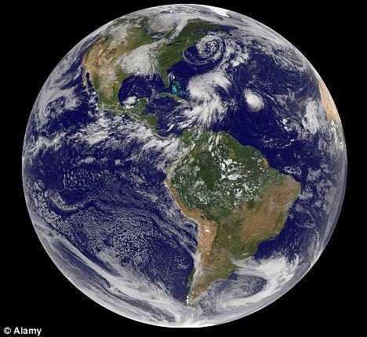

Geography is the study of Earth.

Slide 4
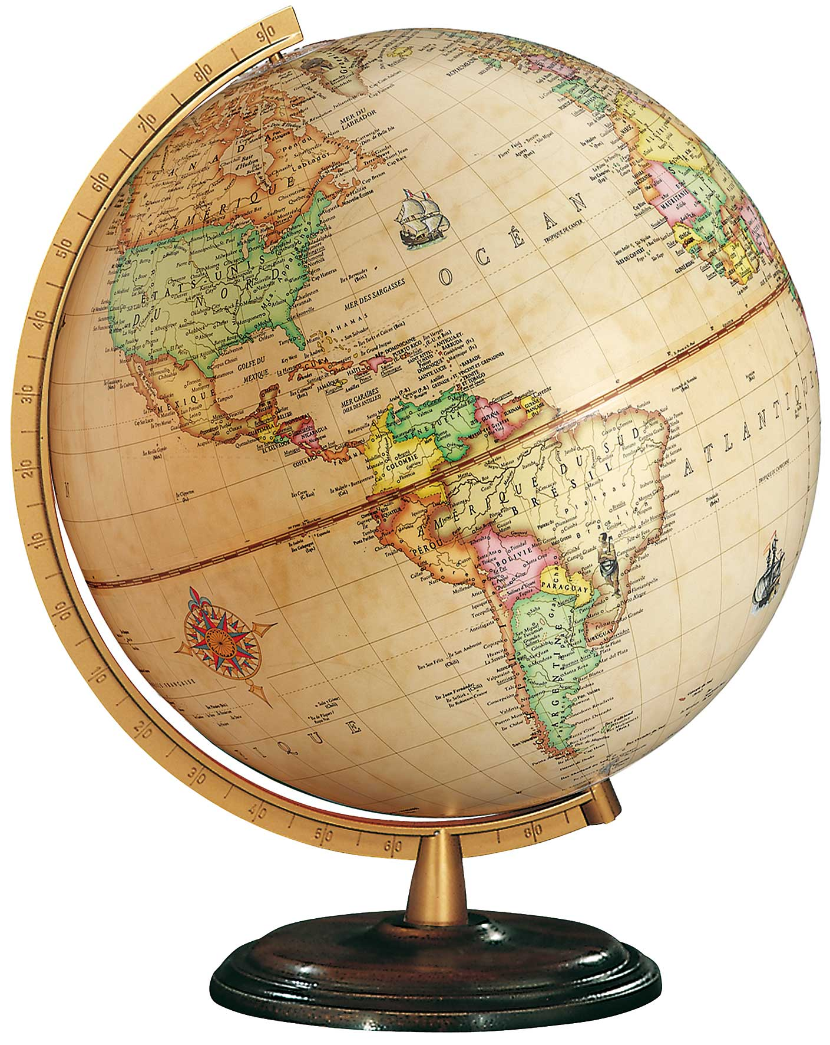
A globe is a small copy of Earth you can hold in your hands.

Slide 5
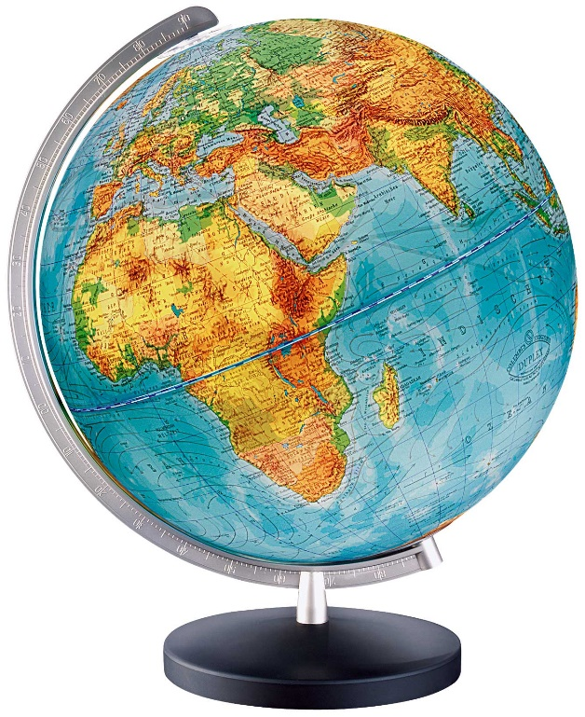
A globe shows continents and oceans. It can also show mountains, rivers, countries, the equator and prime meridian.

Slide 6


Think About It!?!
How are a globe and a map different? List as many differences as you can.
Share your ideas with a partner.

Slide 7
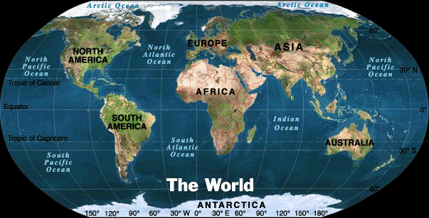
There are seven large landforms called continents and four large bodies of water called oceans on Earth.

Slide 9
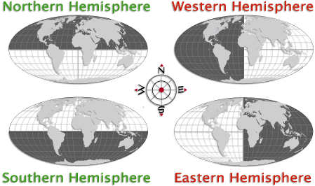
Half the Earth is called a hemisphere. The Earth can be divided in half two different ways.

Slide 10
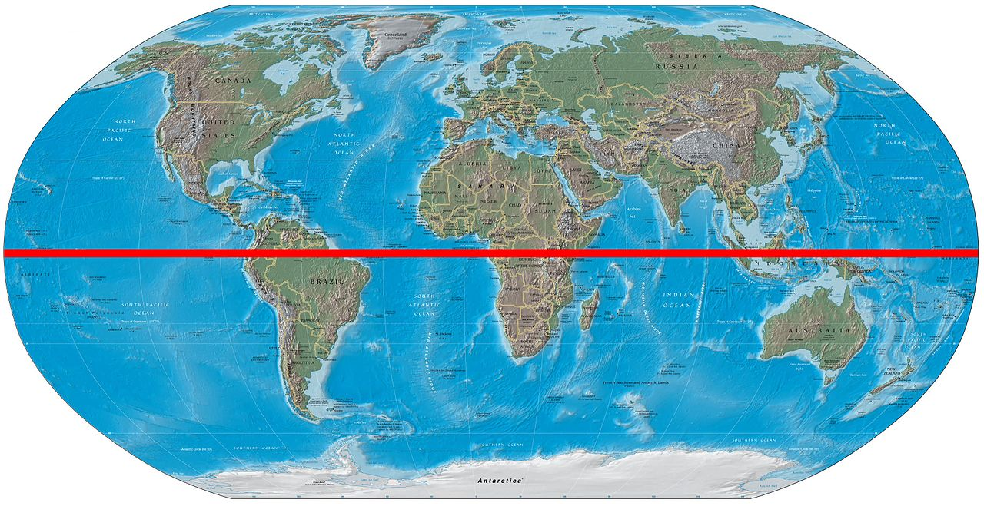
The equator is an imaginary line that divides the earth into a Northern and Southern Hemisphere.

Slide 11
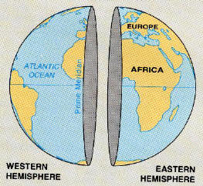
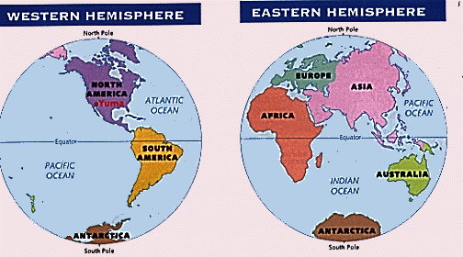
The prime meridian is an imaginary line that divides the earth into an Eastern and Western Hemisphere.

Slide 12
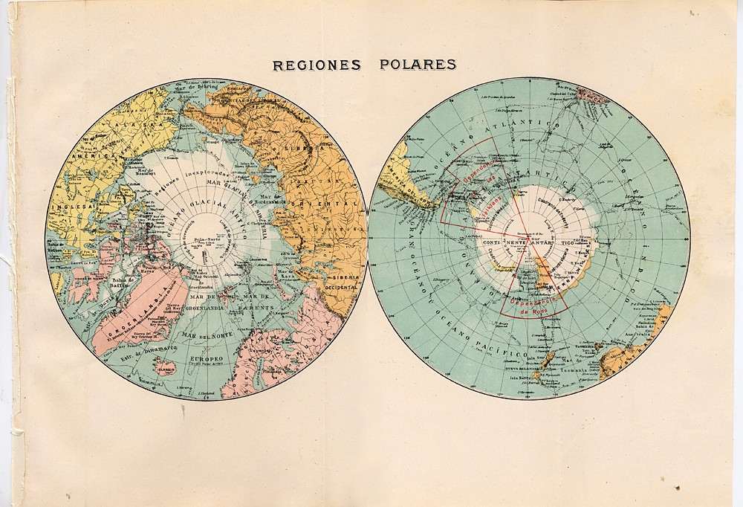
The prime meridian runs from the North Pole to the South Pole.

Slide 13
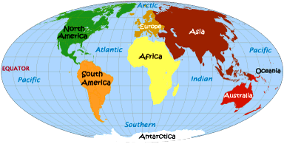
Where Would You Go?
If you could travel to any continent in the world, where would you go? Write three lines describing where you would go and why.
Share with a partner.

